Slide 1

Public Transport Optimization
APSRTC Case Study - Improving Bus Efficiency through Data Insights
Leveraging Scala, Apache Spark, PostgreSQL, and Power BI to transform transportation data into actionable operational intelligence.

Slide 2

Why Public Transport Optimization Matters
The Challenge
Our Goal
Routes experiencing extreme under-utilization or overcrowding
Build a comprehensive ETL pipeline that transforms raw operational data into actionable insights, enabling data-driven scheduling decisions and optimized resource allocation across the entire network.
Inconsistent fuel efficiency across the fleet
Low revenue generation per kilometer traveled
Limited visibility into operational performance
APSRTC operates thousands of bus routes daily across Andhra Pradesh, serving millions of passengers. However, operational inefficiencies create significant challenges:

Slide 3





Tools & Technologies
Scala + Apache Spark
Distributed data processing engine for large-scale ETL operations, handling millions of records efficiently
PostgreSQL
Robust relational database for structured storage, complex queries, and data integrity
Power BI
Enterprise visualization platform for interactive dashboards and executive reporting
CSV Data Sources
Raw operational data from APSRTC systems containing route, passenger, and fuel information

Slide 4





Data Pipeline Architecture
Extract
Raw CSV data from APSRTC operational systems
Transform
Spark processes data: cleaning, enrichment, KPI calculation
Load
Structured tables stored in PostgreSQL
Visualize
Power BI dashboards deliver insights
This modular architecture ensures scalability, maintainability, and clear separation of concerns across the data lifecycle.

Slide 5
Extract Phase: Data Ingestion
01
02
Data Extraction
Key Data Fields Captured
We begin by extracting raw CSV files directly from APSRTC's operational systems, capturing the most up-to-date transportation data.
Each record provides crucial details about the bus routes, including:
route_id: Unique route identifier
depot_name: Operating depot location
passengers: Total passenger count
capacity: Maximum bus capacity
distance_km: Route Kidistance traveled
revenue: Total fare collected
fuel_liters: Fuel consumed
03
04
Schema Validation
Initial Data Cleaning
Upon ingestion, the data is immediately validated against a predefined schema to ensure conformity, consistent data types, and structural integrity across all fields.
We rigorously clean the data by removing any records with missing values in critical fields. Additionally, records with zero distance_km or fuel_liters are filtered out to ensure we only analyze valid and complete operational data.

Slide 6

Transform Phase: Making Data Useful
01
Starting with Clean Data
This phase begins with the clean and reliable data obtained from the 'Extract' step. This ensures subsequent processes are founded on high-quality information.
02
Calculating Key Metrics
Next, critical metrics are calculated to support operational improvements:
Fuel Efficiency
Revenue per Kilometer .
Bus Occupancy
03
Integrating Temporal Data
Time-related information, such as `time_of_day` and `hour`, is incorporated. This enables an understanding of peak travel times, facilitating refined scheduling adjustments.
04
Identifying Aggregate Patterns
All information is aggregated by `route` and month. This process reveals significant patterns over time, such as seasonal variations in ridership or evolving passenger behaviors, supporting proactive planning.
05
Generating Specialized Reports
Customized reports like route performance summaries and detailed fuel consumption analyses are created to guide strategic decisions.

Slide 7

Load Phase: PostgreSQL Storage
The Load phase transfers transformed data into PostgreSQL, making it accessible for analysis while ensuring data quality and integrity.
1
2
Establish Secure Connection
Define and Prepare Schema
The first step is to establish secure connections to the PostgreSQL database, preparing for data transfer.
Once connected, define the necessary table schemas and create specialized analytical tables, including setting up strategic indexes for optimal query performance:
fuel_efficiency_top_bottom
revenue_per_km_top_bottom
load_factor_summary
peak_congestion_day_month
underutilized_routes
overcrowded_routes
3
4
Load Transformed Data
Perform Data Integrity Checks
With the database and tables prepared, efficiently transfer the validated and transformed data into the newly structured tables.
After loading, rigorously validate the integrity and quality of the transferred data to ensure accuracy and completeness for subsequent analysis.

Slide 8
Key Performance Indicators for APSRTC
Key Performance Indicators (KPIs) are vital, quantifiable metrics that reflect how effectively APSRTC is achieving its key business objectives, enabling data-driven decisions for improved efficiency and service quality.
1
Occupancy Rate
Formula: (Passengers / Total Seats) × 100% - Measures passenger capacity utilization; high rates indicate efficient resource use.
Fuel Efficiency
2
Formula: Distance (km) / Fuel Consumed (liters) - Critical for cost control, identifying inefficient vehicles, and reducing environmental footprint.
3
Revenue per KM
Formula: Total Revenue / Total Kilometers Operated - Measures financial productivity per kilometer, helping identify profitable routes.
4
Load Factor (%)
Formula: (Actual Usage / Max Capacity) × 100% - Measures overall vehicle capacity utilization for optimal deployment.
5
Peak Congestion
Metric: Delay Duration & Frequency (Peak Hours/Days) - Focuses on mitigating high-demand challenges and optimizing scheduling.
These KPIs provide actionable insights for route optimization, fleet allocation, and service scheduling, ultimately enhancing operational efficiency and improving the passenger experience for APSRTC.

Slide 9
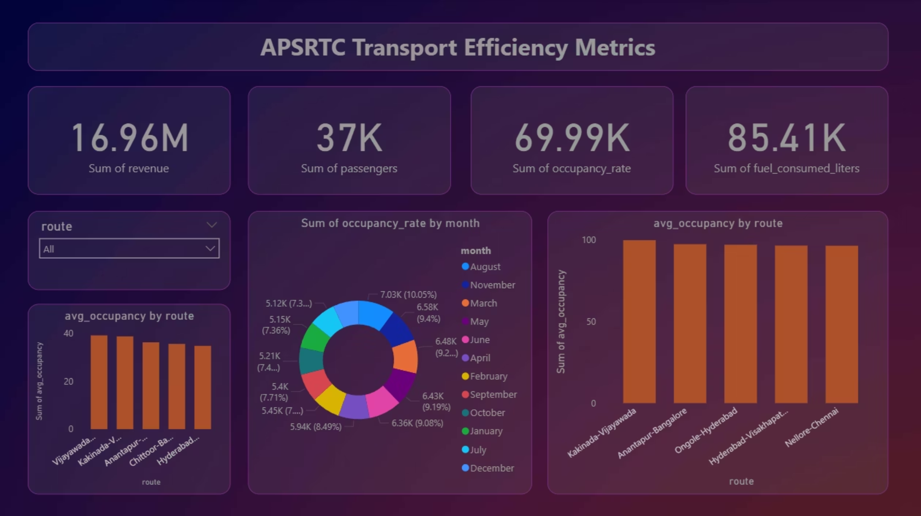
Power BI Dashboard: Actionable Insights

Slide 10




Route Performance Analysis
Kakinada-Vijayawada
High demand corridor, consistently showing strong occupancy rates.
Hyderabad-Visakhapatnam
Major city connection with significant passenger traffic.
Seasonal Patterns
August and May are identified as peak months for passenger demand and occupancy.
These insights help prioritize route adjustments, resource allocation, and targeted marketing efforts.

Slide 11


Results & Strategic Recommendations
Key Findings
Actionable Recommendations
Major city routes consistently maintain occupancy rates exceeding 70%
Reallocate fleet resources from low-demand to high-traffic routes
August and May demonstrate seasonal passenger demand peaks
Deploy additional buses during peak congestion months
Efficient routes correlate strongly with shorter distances and higher occupancy
Establish monthly performance monitoring using dashboards
Fuel consumption patterns reveal optimization opportunities
Integrate driver behavior and fuel tracking systems
Impact: Data-driven decision-making enables APSRTC to optimize operations, reduce costs, improve passenger satisfaction, and maximize revenue across the entire transportation network.

